Slide 1


ABACUS
THE NEXT GENERATION MATHEMATICS

Slide 2
WHAT IS ABACUS
Abacus is a tool to perform basic mathematical operations like addition, subtraction, multiplication and division.
The tool contains one horizontal bar and usually 13 or 17 vertical rods with movable beads.
Each vertical rod has one bead of value five above the horizontal bar and four beads of value one each below horizontal bar.

Slide 3
Left & Right Brain
Linear
Words
Mathematics
Logic
Analysis
Sequencing
Language
Facts
Imagination
Rhythm
Photographic
Creativity
Art
Visualization
Non Verbal
Feelings

Slide 4
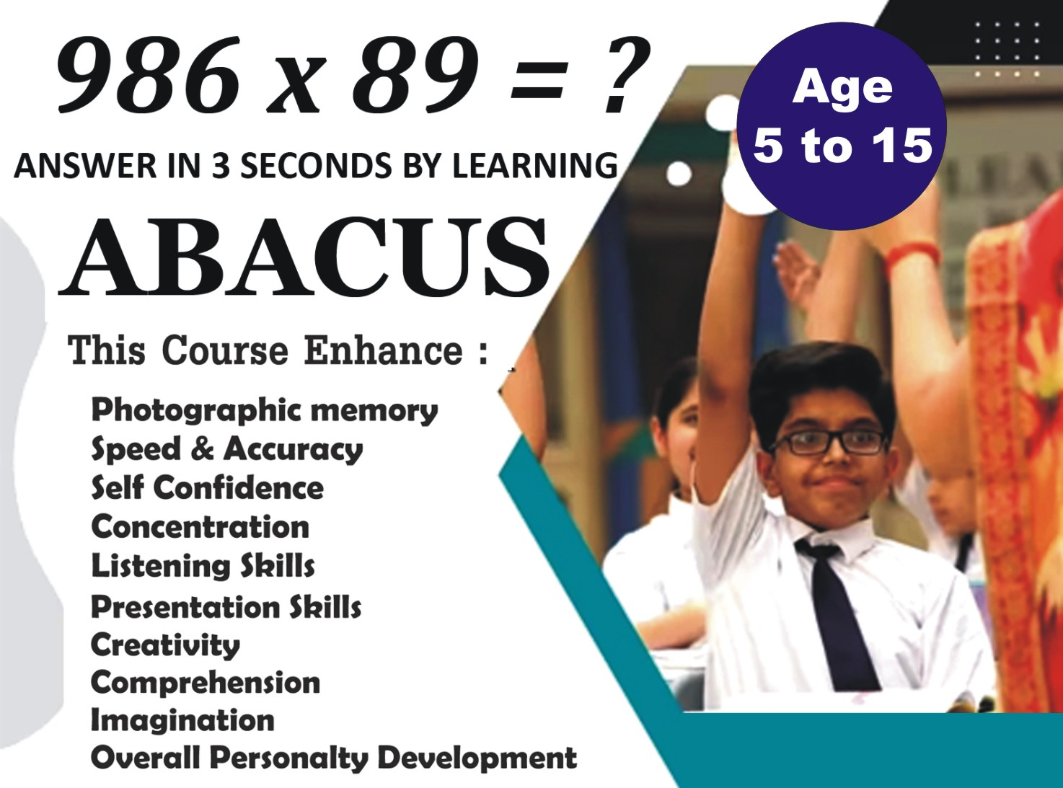

Slide 5
Power Of Right Brain
High Calculation Speed with Accuracy
Makes mathematics an interesting subject
Develops Power to Concentrate
Develops Observation & Visualization Power
Develops Memory Power
Develops Confidence and Self esteem

Slide 6
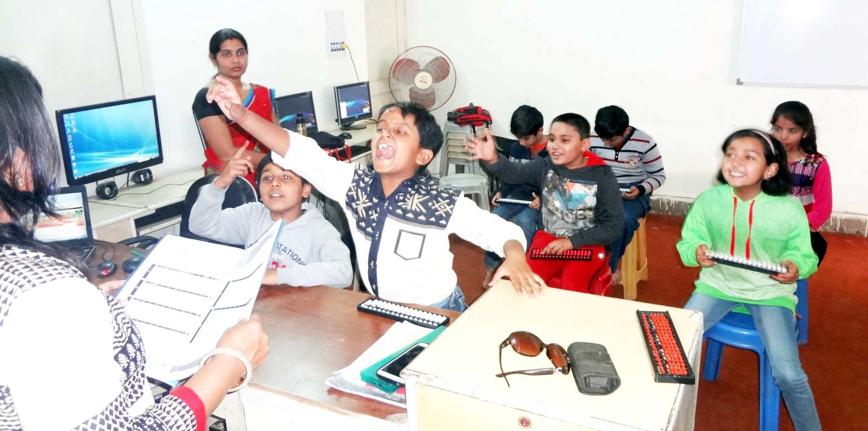
Power Of Right Brain
High Calculation Speed with Accuracy
Makes mathematics an interesting subject
Develops Power to Concentrate
Develops Observation & Visualization Power
Develops Memory Power
Develops Confidence and Self esteem

Slide 7
ELIGIBILITY
Age group : 5 to 15 years

Slide 8
COURSE DETAILS
Levels : 10 (Each of 2 months)
Duration : 2 Year. (Minimum practice of 15 minutes daily)
Course Content : Addition, subtraction, multiplication, division, etc.
Maximum Age : 15 years of age. After that age, Vedic Maths learning is more suitable.

Slide 9
HOW TO LEARN - BEST METHOD
Online Abacus Classes by Certified Trainer
Teaching your child yourself
Sending your child to a good abacus Training center

Slide 10
Abacus Classes for kids
You can also opt for online abacus classes and get your child trained by our certified trainer.
Benefits of online classes are below:
Saves your time and money You need not go to any Abacus Institute. Thereby, you save time as well as transportation costs. Online program is always economical as compared to the fees charged at centers.
One child at a time: You get dedicated trainer for your child who will focus on training your child only during the allotted time slot.

Slide 11
Abacus Classes for kids
Similar to a home tuition for your child.
Reasonable fee.
Playway technique of teaching.
Training by Certified trainers.

Slide 12
Teach Your Own Child
Yes, it is true! You can teach your kid easily.
Roots Abacus has a very effective program (Online Abacus Teacher Training Course) for this purpose.
This is the most recommended method, provided you teach your kid yourself.

Slide 13
Teach Your Own Child
Following are the salient features of the course:
No maths expertise required.
You teach/are willing to teach your own kid.
You can learn from home without going anywhere.

Slide 14
Abacus Teacher Training
Abacus Teacher Training Course is easy, and can be done in a short period of time.
After completing this course, you become the trainer for your child.
Who could be a better teacher for a child than a child's own parents.
You would also be available for your child any time he or she faces a problem while learning. For more details regarding the online abacus teacher training course.
The last method to make your child learn abacus is making him/her join regular weekend abacus classes near your house

Slide 15
WHY US ?
ISO 9001:2008 Certified.
Affordable training fees
Well planned training program
Effortless & Tech. Assisted Learning through our certified trainers.
Software based practice methods to get expertise on the subject
Software-based monitoring of Speed and Accuracy
Regular reporting of all activities.
Support via Telephone No. WhatsApp chats, emails, etc.
Interesting and engaging teaching Method
Online & Offline competitions

Slide 16
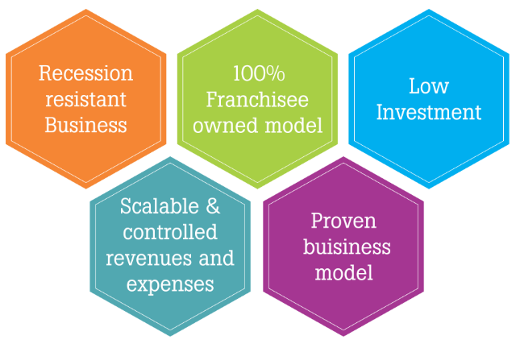
FRANCHISE

Slide 17
ABACUS TEACHER TRAINING
Teacher training classes : You can become an Abacus trainer by completing the course in class or even online.
You can then open your own abacus training center and earn handsome money.
The course is of short duration, easy to understand and very interesting.
You need not be expert in maths for doing this course.

Slide 18
ABACUS TEACHER TRAINING
Viva Abacus franchisees do not need any prior technical experience to effectively operate a franchise.
Our comprehensive initial training program includes engaging, in-depth, informative classes on all technical matters, Marketing, operations and technology.
You will complete training with the confidence and knowledge necessary to succeed.
The training sessions would be taken by our Certified Trainers having good experience.

Slide 19
FRANCHISE
You and your trainer will work side-by-side working with employees, initiating marketing activities, and ensuring all of your Process is functioning properly prior to completing your first job.
During your training program, you would refine your working knowledge in:

Slide 20
FRANCHISE
Viva Abacus Learning School encourages you to be a part of our franchise network and get the opportunity to grow with us.
We provide all support required to open up your own center.
If you are interested in spreading education all over the world with latest innovations join us now.
Our focused support services provide valuable experience and information to its franchisees to ensure their growth and success.

Slide 21
FRANCHISE
Administration
Customer Service
Personnel Management
Advertising Planning
Technical Proficiency

Slide 22
WHY US?
Lowest Abacus teacher training fees
No Franchise Cost
Well planned training program. (Online as well as Offline)
Effortless & Technology Assisted Learning for trainers
Offline practice worksheets to get expertise on the subject
Door step service for all study material and Abacus tools required
Marketing & Development support after course completion
Enquiries coming from your area/region will be forwarded to you.

Slide 23
WHY US?
Free Performance sheets to monitor your students' performance
Software to regulate Speed and Accuracy for every student
Regular updates of all activities of the child to parents and trainer
Regular interaction with trainers to understand and resolve their day to day queries
Play way teaching Method for kids.
Online Tests for Kids to learn the course effortlessly
Regular competitions for kids

Slide 24
IMPORTANCE & BENEFITS OF
VIVA FRANCHISE
Trademarks
  You will be eligible for using trademark of Roots to be displayed on your sign boards, pamphlets, and other publicity material.

Slide 25
IMPORTANT TERMS
& CONDITIONS
Certification
After successfully completing the course, Student will be awarded as a Certified Student of Viva Abacus, an ISO 9001:2008 Certified Company.
Royalty
No Royalty

Slide 26
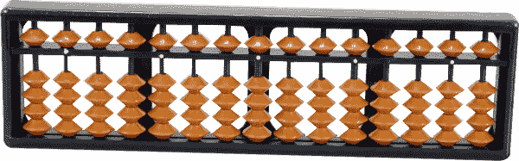
Roles & Responsibility
Viva Technologies
  Books
  Abacus Tool
  Hearing Exercise for Parents
  Training to Faculty
  Students Test
  Student Assessment
  Competitions:
  How to get the best performance from students:
  Parent-Teacher Sessions:
  Software & Technology
  Marketing strategies:
  Online Marketing: Facebook, Twitter, Instagram Etc.
  How to handle Parents & Students enquiries.
Franchise
  Trainer or Faculty
  Class Facility

Slide 27
IMPORTANCE & BENEFITS OF
VIVA FRANCHISE
Customer Support
  Marketing strategies:
  Online Marketing:
  How to handle enquiries:
  Teaching students effectively:
  Competitions:
  How to get the best performance from students:
  Parent-Teacher Sessions:
  Parents' queries:

Slide 28
Our Existing Branches
53, Mayur Market, Thatipur, Gwalior
B1, B2 Chauhan Piyau, Morar, Gwalior
Sukh Mansion, Vinay Nagar, Gwalior
Kids Paradise School, DD Nagar, Gwalior
106, Yamuna Nagar, Darpan Colony, Gwalior
Crest International School, Dabra
JP public School, Datia
and many More……………

Slide 29
Contact us
Viva Technologies - 53, Mayur Market, Thatipur, Gwalior
94257-01888
94257-02888
94257-03888
E-mail: vivatechgwl@gmail.com

